Slide 1


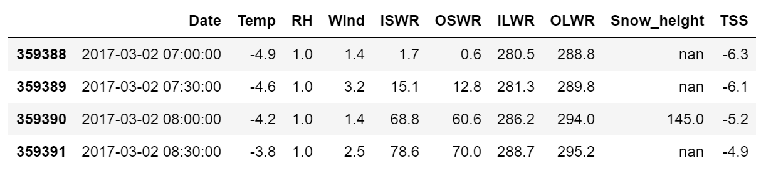
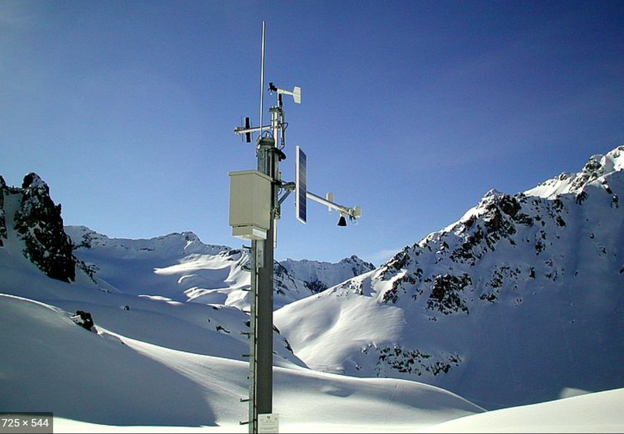
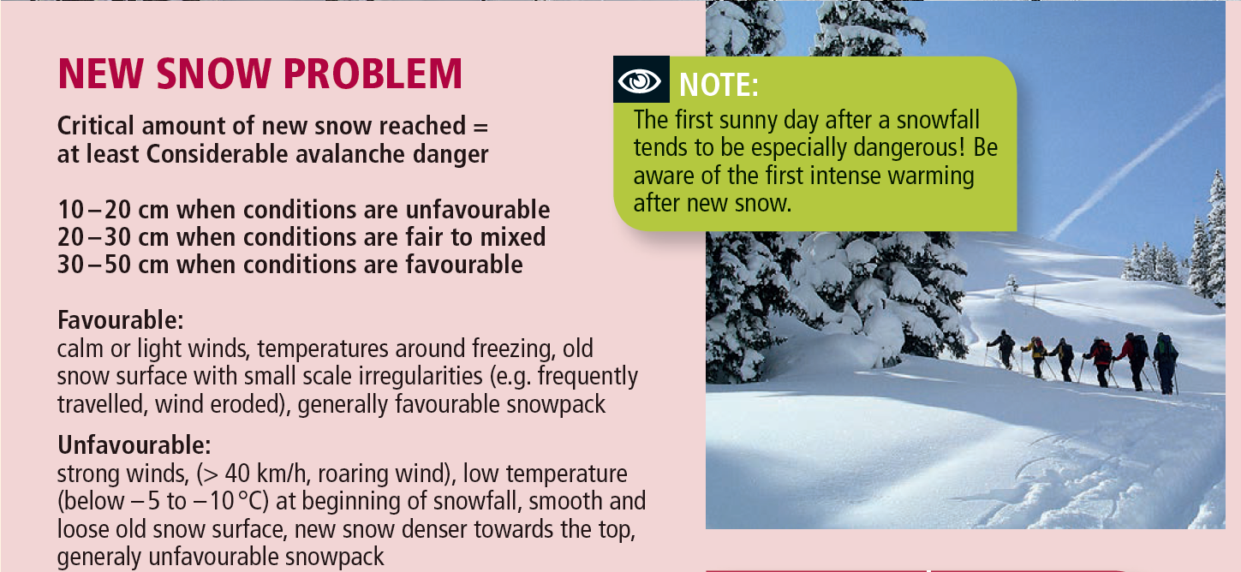
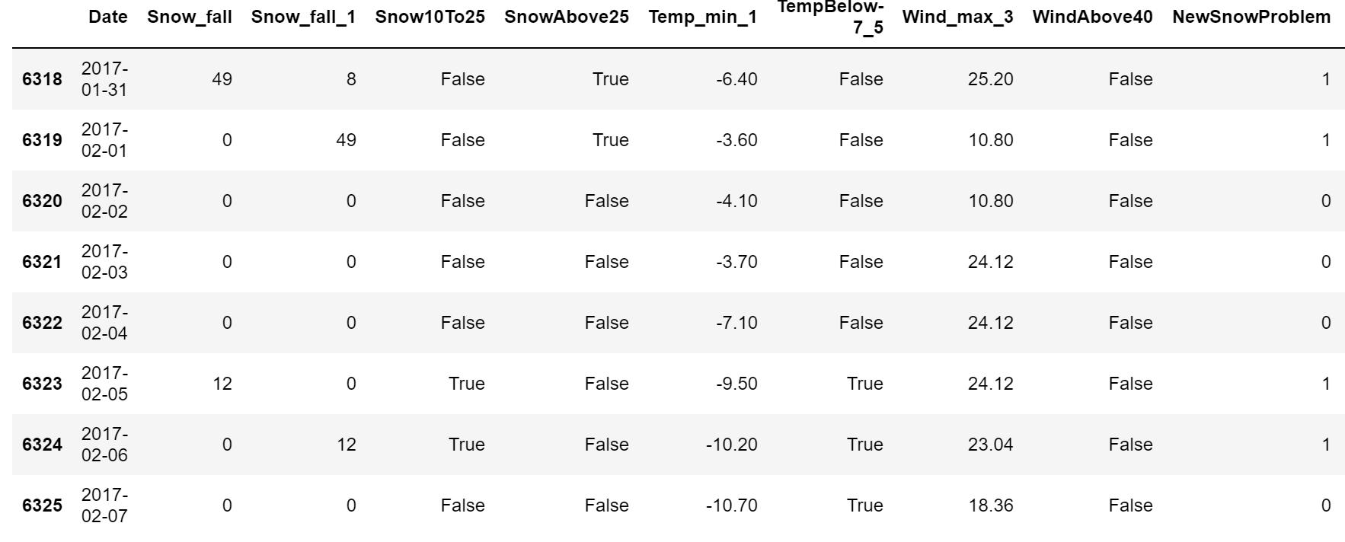

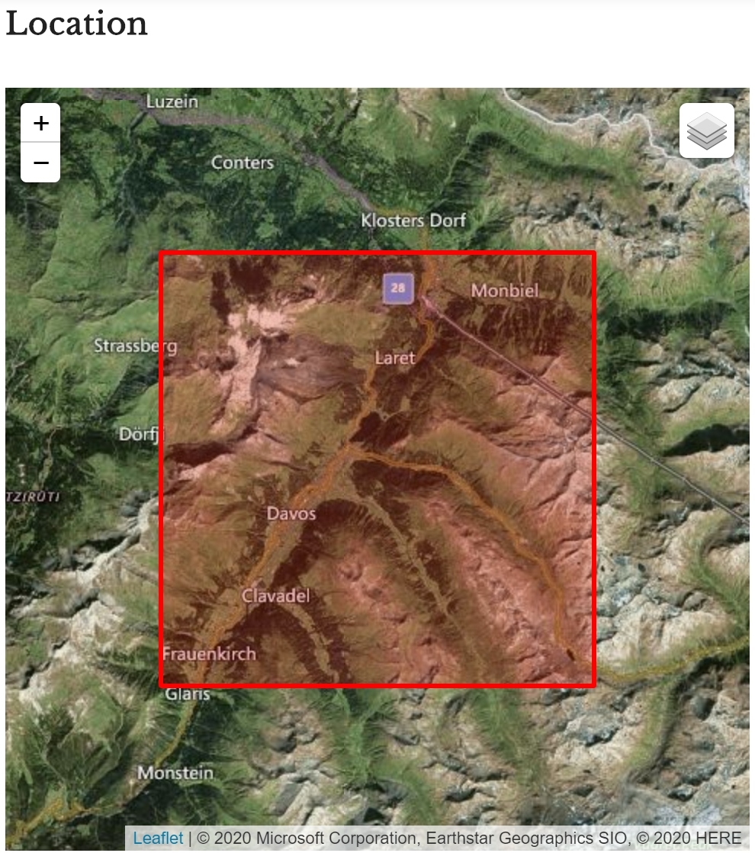
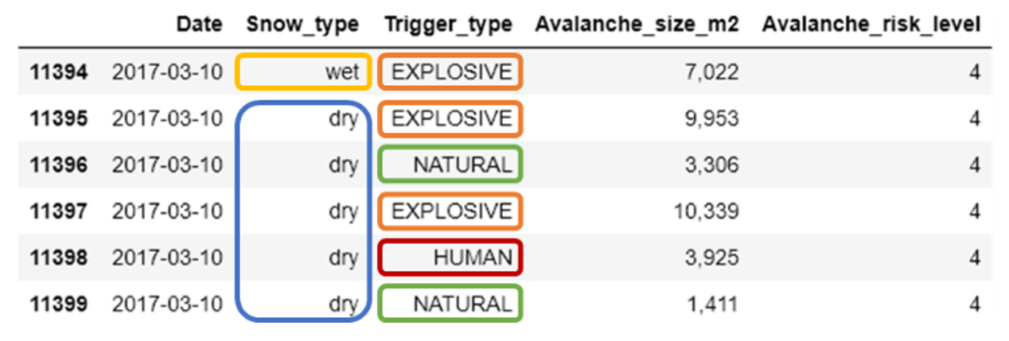
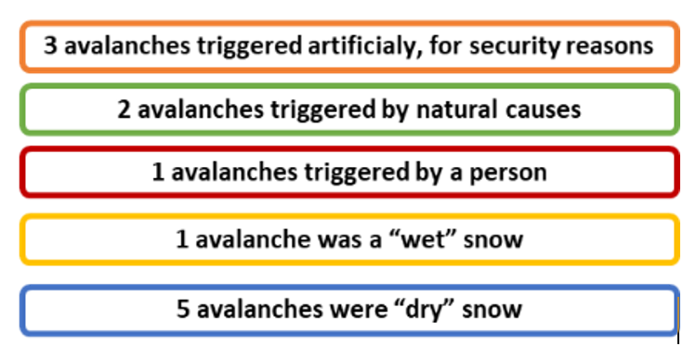
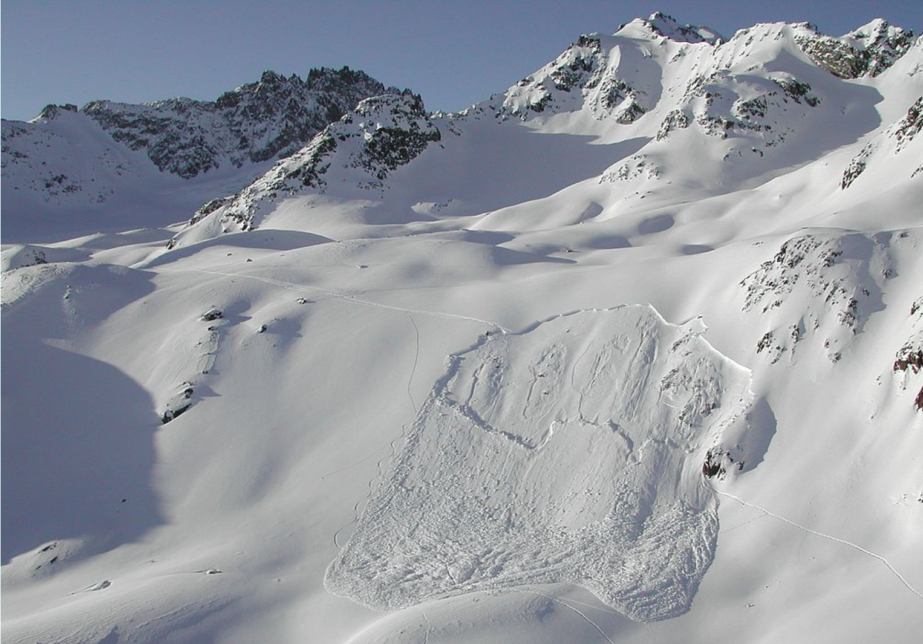
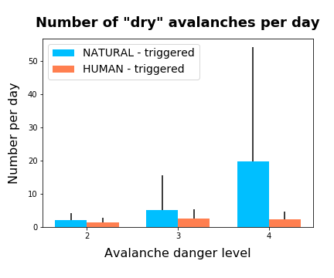
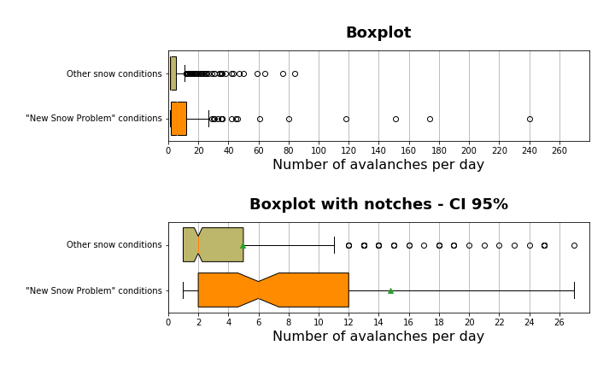
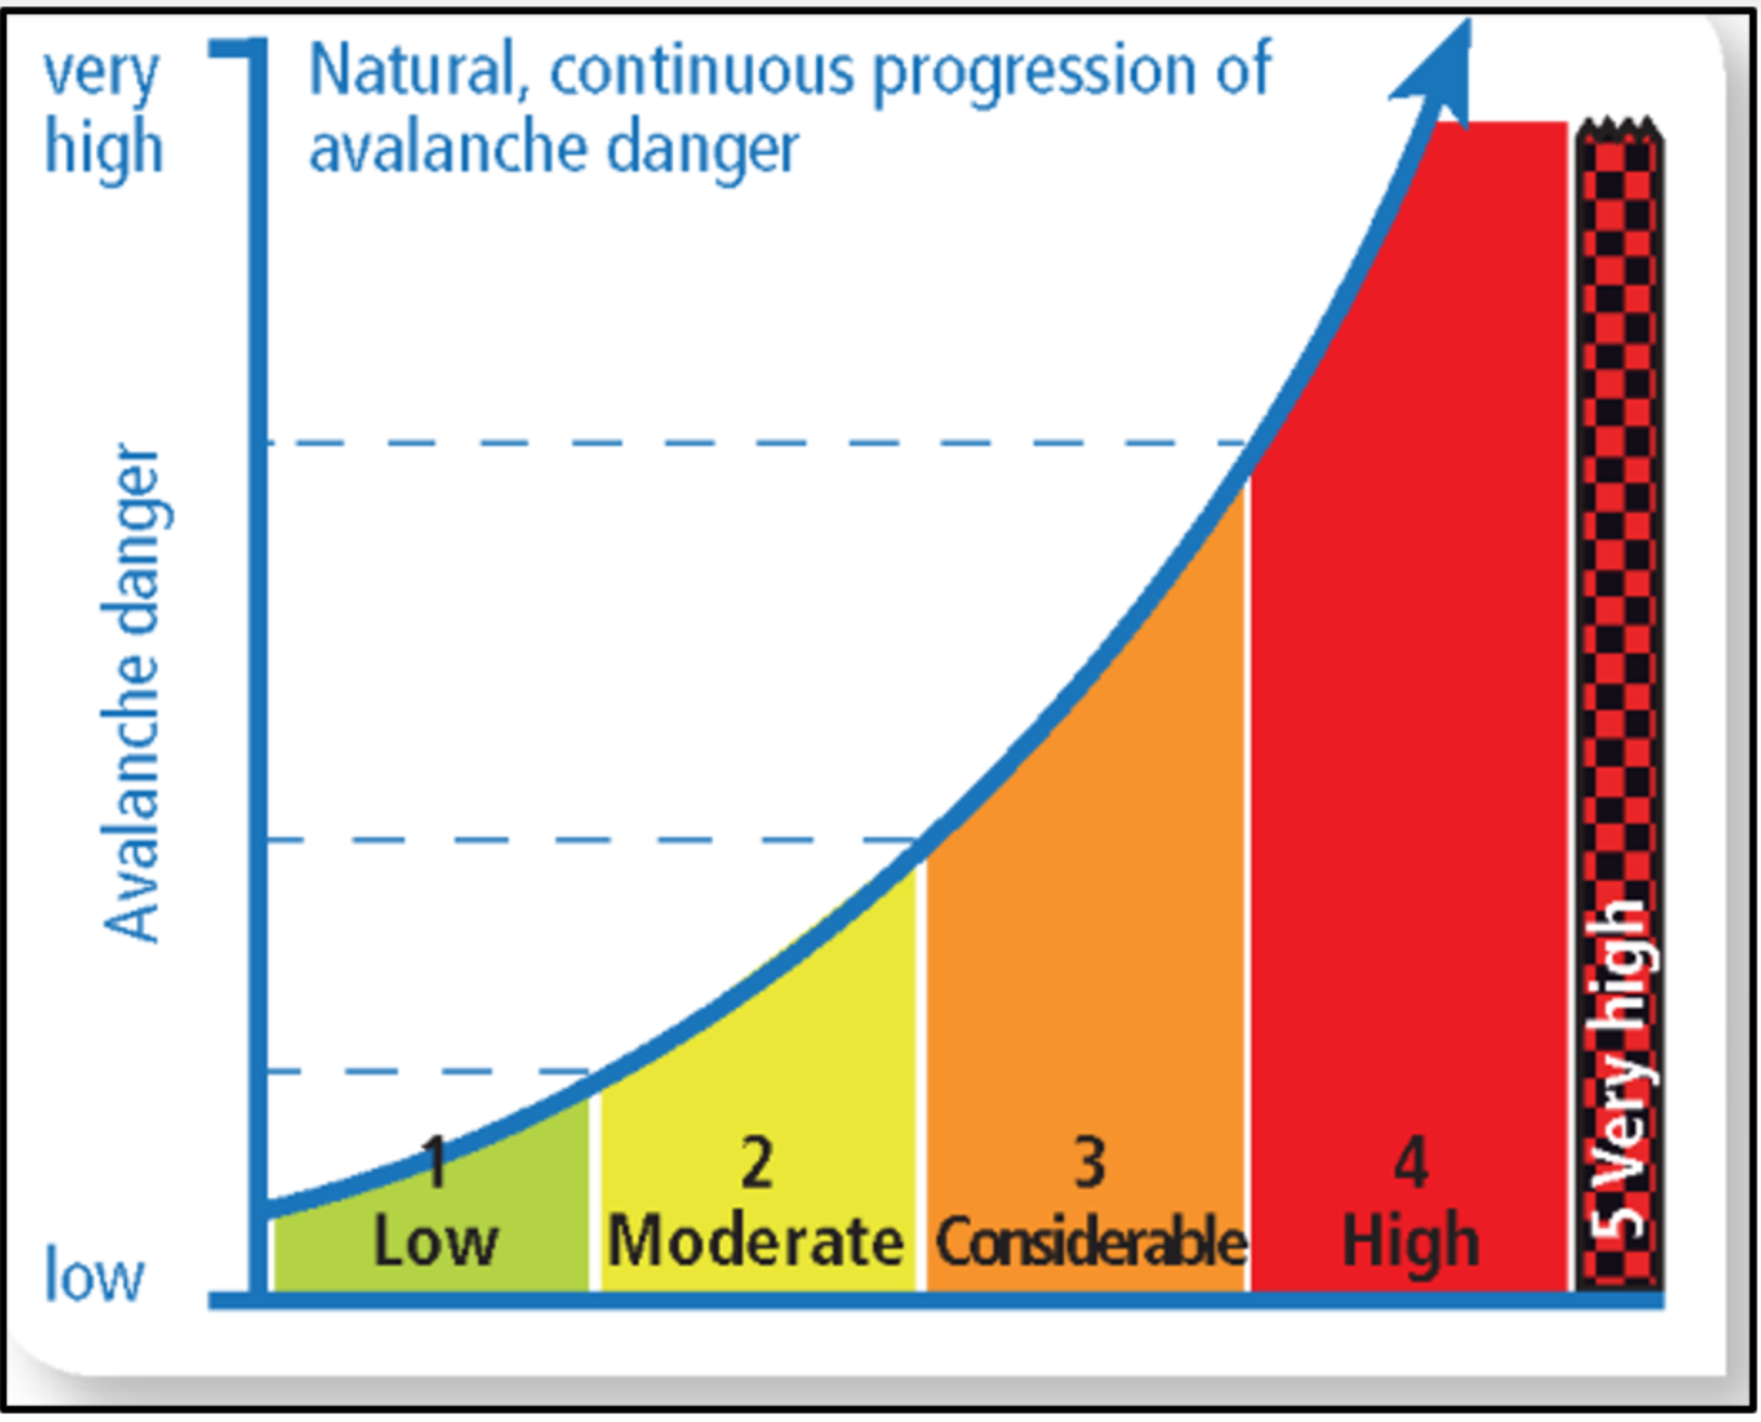
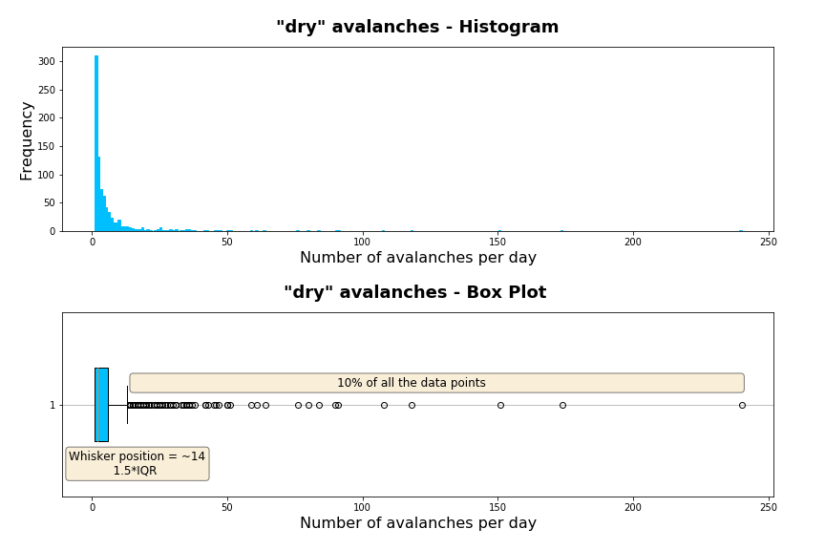
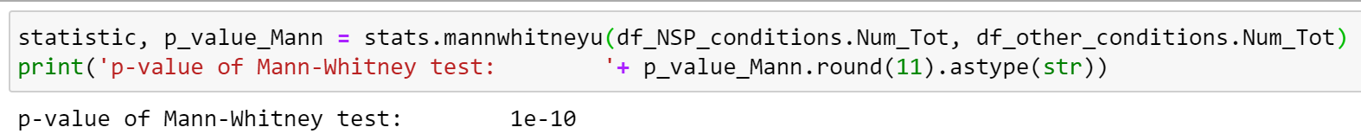
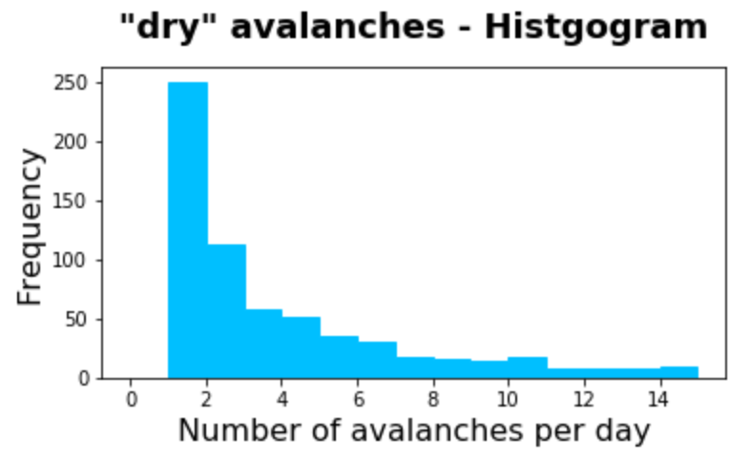
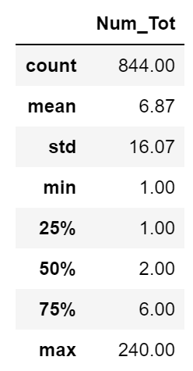
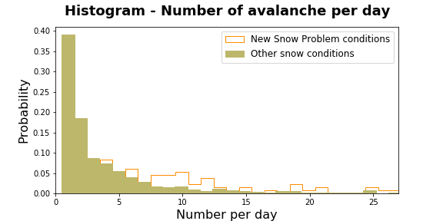
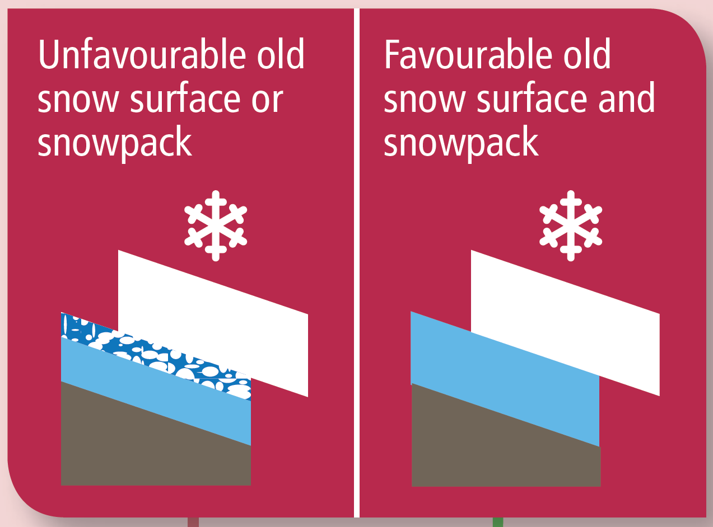
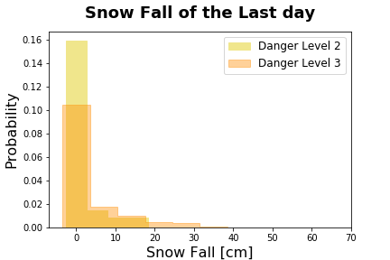
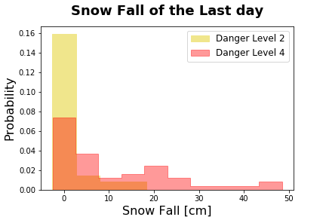
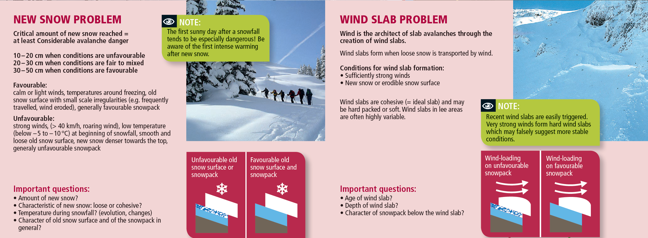
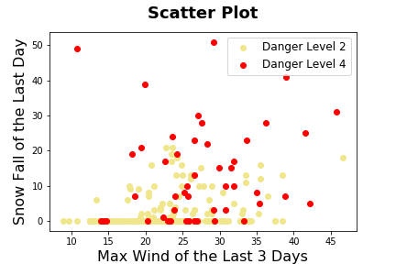
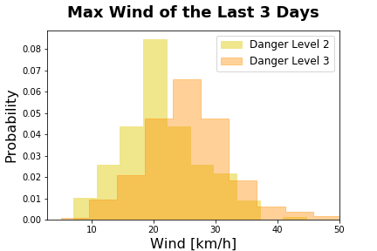
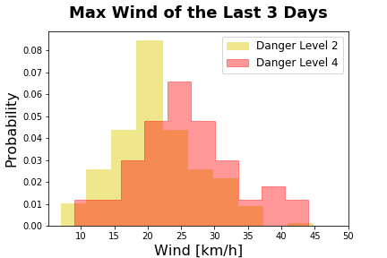
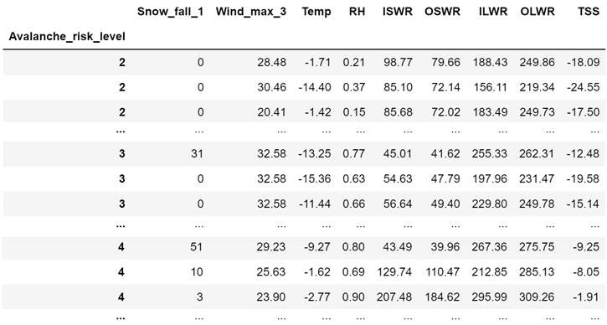
CAS Applied Data Science – Module 2 Project – Lionel Perret – 16.10.2020
Analysis of Avalanches within Davos Area
in relation with
Weissfluhjoch Weather Data
Overview and Concept
DATA SET 1
Weissfluhjoch
Meteorological and snowpack measurement
«New Snow Problem»:
Binary variable
Temperature, Relative Humidity, Wind speed, Incoming/Outgoing radiation,
Snow Height (manualy measured between 6h-9h), Snow surface temperature, Groud temperature, …
Combine data
and
analysis
Module 2 – Project
Objective 1:
Analysis of number of avalanches per day with regards to avalanche danger level
Objective 2:
Influence of new snow and other meteo parameters on number of avalanches per day
Davos
~ 17km
DATA SET 2
13’918 Recorded
Snow avalanches
1999-2019
Module 3 – Project
Prediction of avalanche danger level
with meteo parameters
Objective 1: Analysis of number of avalanches per day with regards to avalanche danger level
Objective 2: Influence of new snow and other meteo parameters on number of avalanches per day
NATURAL triggered avalanches:
➔Number per day increases with the danger level
HUMAN triggered avalanches:
➔~2 avalanches per day
Median
"New Snow Problem“: 6 avalanches per day
Other snow conditions: 2 avalanches per day
➔As the notches do not overlapped, the 2 medians are not the same (with 95% CI)
Mean (Green triangle in box plot):
“New Snow Problem”: ~15 avalanches per day
Other snow conditions: ~5 avalanches per day
➔Those 2 distributions do not have the same mean
“Number of dry avalanche per day”:
➔Not a normal distribution, can look first like Poisson
Box plot:
➔These points cannot be considered as “outliers”
In some conditions, there are large number of avalanches per day
Distributions are not normal:
Mann-Whitney test can be used to compare those 2 distributions
mean != variance
➔High number of avalanches per day present in “Other snow conditions”, what causes it?
➔One explanation could be “Unfavorable snow Surface or Snowpack before the new snow is falling
Unfavorable snow surface/snowpack
Project Module 2
Conclusion
Project Module 3: Outlook and open questions
Prediction of avalanche danger level with meteo parameters
Number of avalanche per day: ➔Consistent with definition of European avalanche danger level
New Snow Problem (with wind/temperature): ➔ Influence on the number of avalanche per day
Other parameters like Snow Surface/snowpack and presence of windslab needs to be considered
Those parameter tends to be “very local”
➔ so very important to have “precise” and “localized” meteo paramete
Filtering possibilities….
Snow of the last day:
➔ Some distributions differences mainly between Danger level 2 and Danger Level 4
Max wind of the last 3 days
Some distributions differences between Danger Level 2 and Danger Level 3/4
Avalanche danger level prediction
Enough data for machine learning ?
Level 2
207 rows
Level 3
444 rows
Level 4
48 rows

